Slide 1
SESSION TITLE
Add speaker names here
track name and URL here & anything else

Slide 2
TITLE SLIDE
SUBTITLE IF REQUIRED

Slide 3
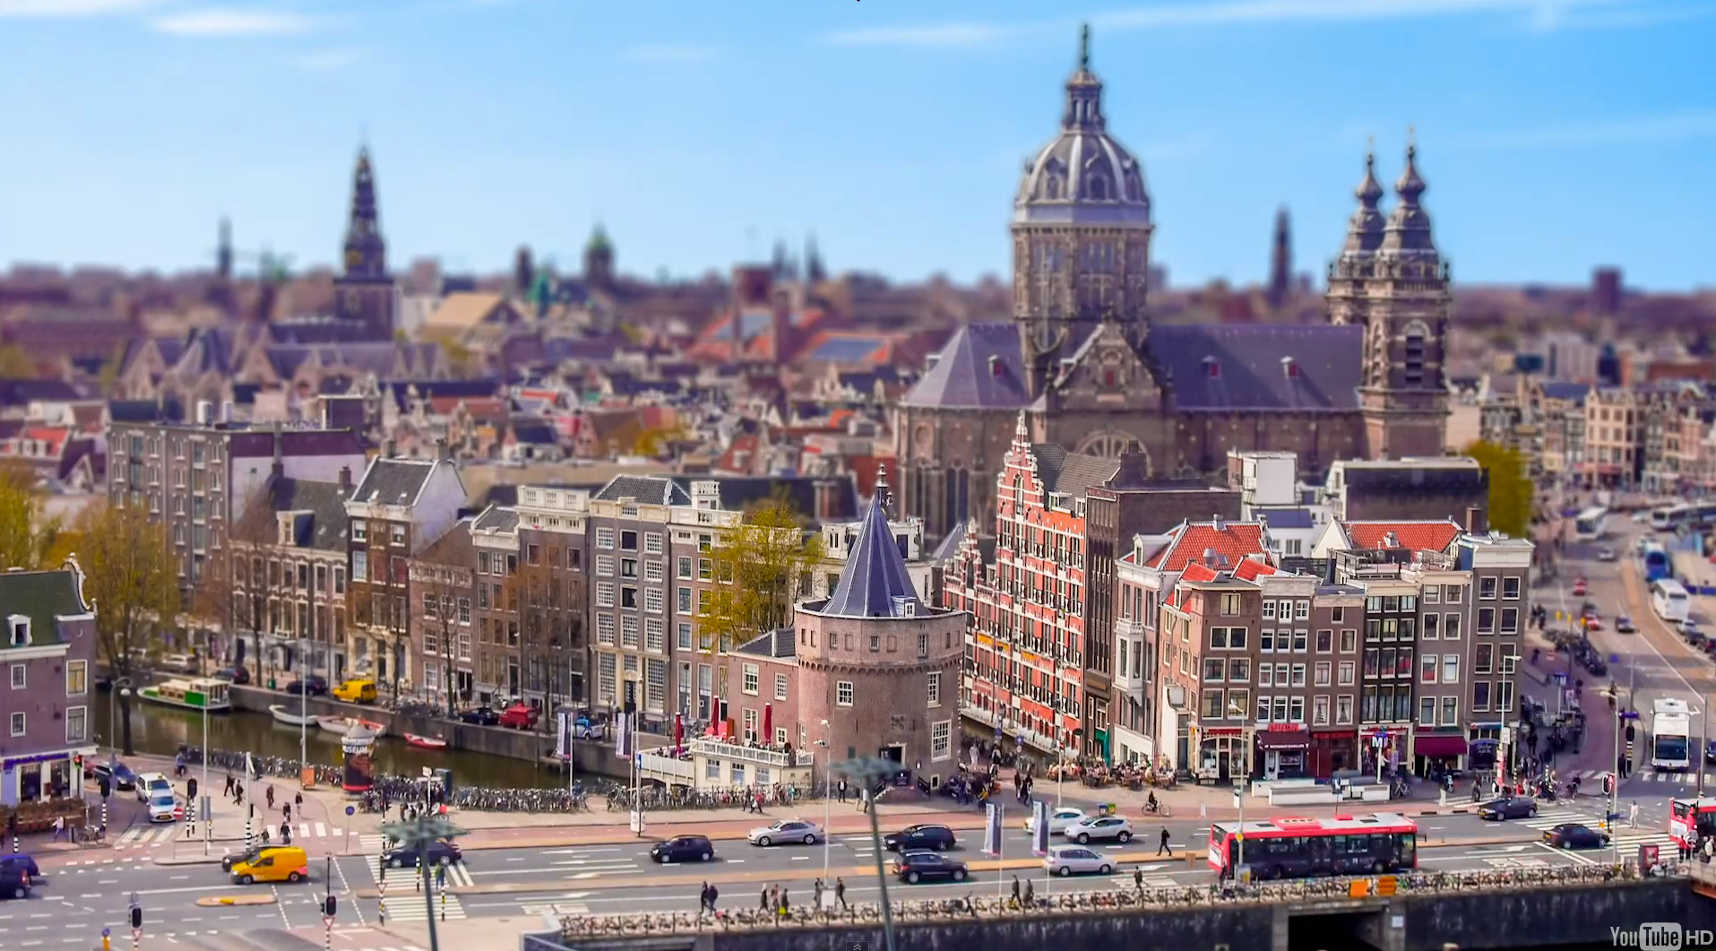
MAIN HEADER
Caption goes here

Slide 4
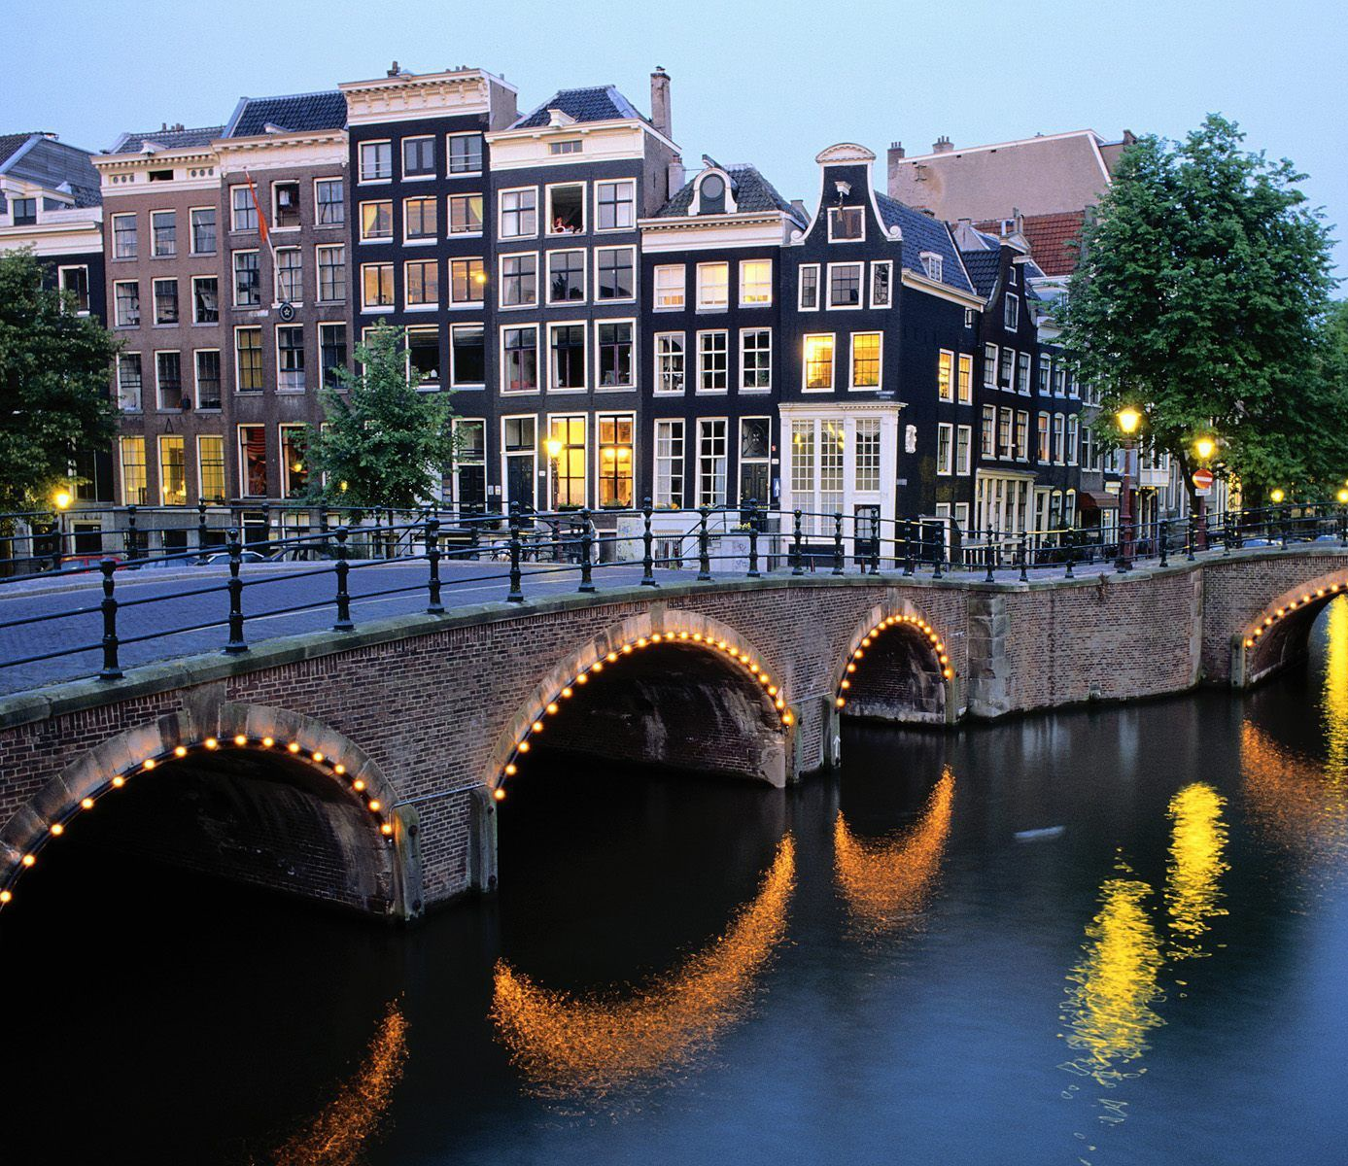
MAIN HEADER
Sub Header
rles Truffaut keffiyeh hoodie pickled, brunch +1 Austin meggings kogi. Ethical seitan twee flannel. Williamsburg crucifix authentic mustache messenger bag, umami Godard literally Blue Bottle chia. Direct trade iPhone leggings gluten-free before they sold out. Ethnic four loko shabby.
Caption goes here

Slide 5
MAIN TITLE
List item 1
List item 2
List item 3
List item 4
List item 5
List item 6

Slide 6
MAIN TITLE
Sub Header
rles Truffaut keffiyeh hoodie pickled, brunch +1 Austin meggings kogi. Ethical seitan twee flannel. Williamsburg crucifix authentic mustache messenger bag, umami Godard literally Blue Bottle chia. Direct trade iPhone leggings gluten-free before they sold out. Ethnic four loko shabby.
msburg crucifix authentic mustache messenger bag, umami Godard literally Blue Bottle chia. Direct trade iPhone leggings gluten-free before they sold out.

Slide 7
MAIN TITLE
Sub Header
rles Truffaut keffiyeh hoodie pickled, brunch +1 Austin meggings kogi. Ethical seitan twee flannel. Williamsburg crucifix authentic mustache messenger bag, umami Godard literally Blue Bottle chia. Direct trade iPhone leggings gluten-free before they sold out. Ethnic four loko shabby.
rles Truffaut keffiyeh hoodie pickled, brunch +1 Austin meggings kogi. Ethical seitan twee flannel. Williamsburg crucifix authentic mustache messenger bag, umami Godard literally Blue Bottle chia. Direct trade iPhone leggings gluten-free before they sold out. Ethnic four loko shabby.

Slide 8
“this will be a quote about something by someone”
– NAME OF xxx

Slide 9
MAIN HEADER
Sub Header
msburg crucifix authentic mustache messenger bag, umami Godard literally Blue Bottle chia. Direct trade iPho.

Slide 10
SPONSOR SLIDE

Slide 11
WHAT DID YOU THINK?
EVAULATE THIS SESSION - AmSTERDAM2014.DRUPAL.ORG/schedule
THANK YOU!

